Slide 1

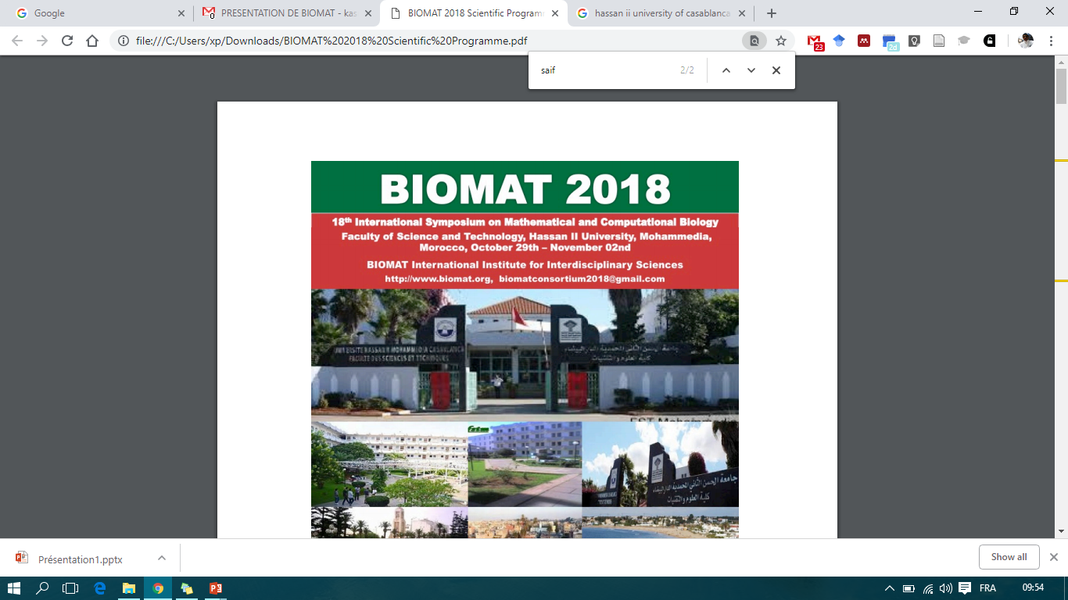


Mathematical Model for Predicting
the Hypermethylations in the Tumor Suppressor
Gene Promoters as a Cause of Cancer
Imane Saif,
Najwa Hassou,
Yassine Kasmi,
Berjas Abumsimir,
Karam Allali,
My Mustapha Ennaji,
“We are express of gene and maturation
of the environment”
YK
Hassan II University, Casablanca, Morocco

Slide 2
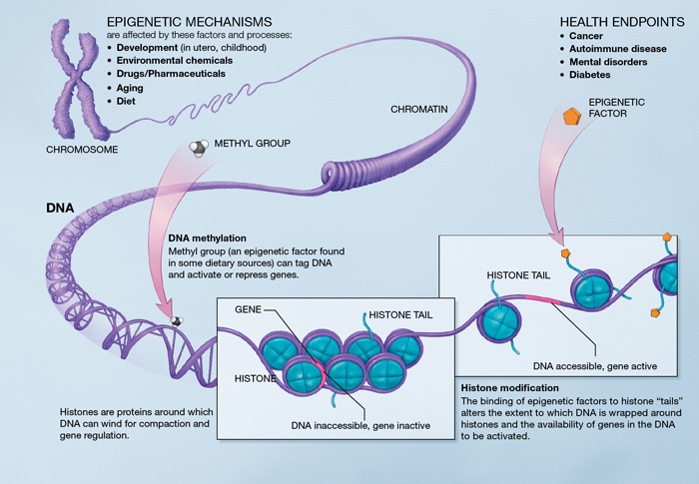
Biological Background

Slide 3
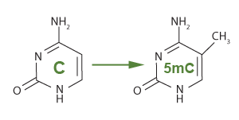
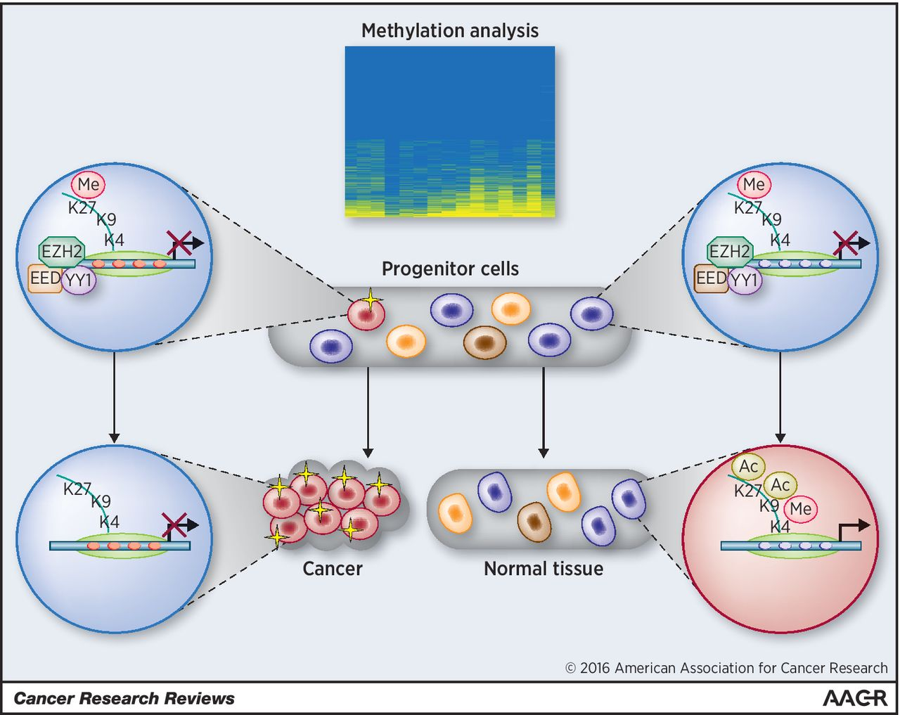
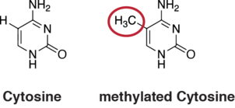
Biological Background

Slide 4
Computational Analysis of Methylation
Methylation Analysis
Whole genome
Profiling
Predictive Model
NGS
BS
HMM
MCMC

Slide 5

Computational Model
where aij is the probability of transition between the states
el(i) the probability to observe element i(strands for C or G) in state l ; pk(j; x-1) is the probability of the most probable path ending at position x-1 in state k with element j; pkl is the probability of the transition from state l to state k.

Slide 6
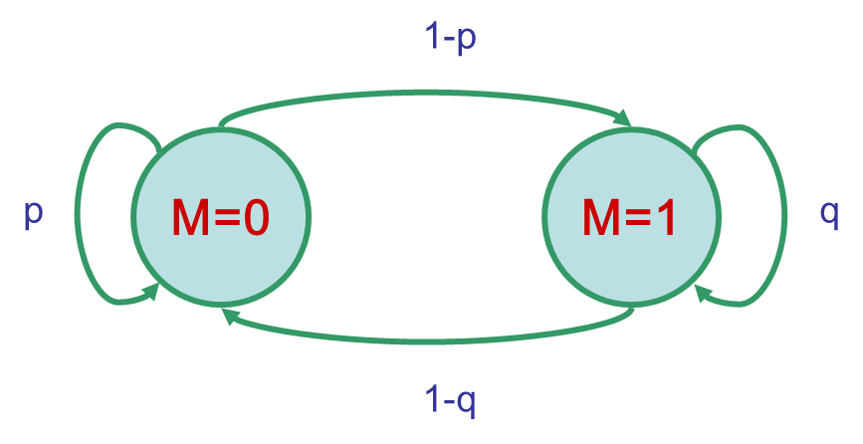
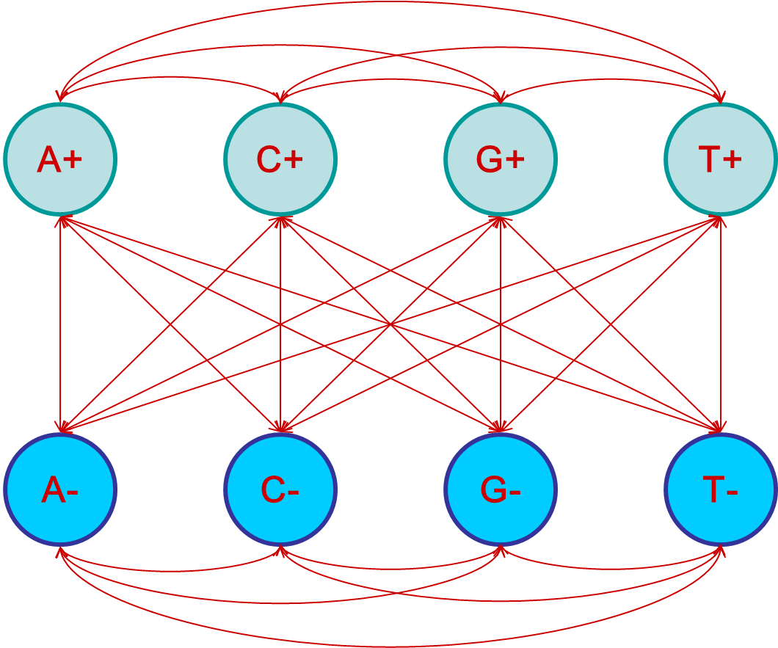
Computational Model

Slide 7
Computational Model
Viterbi
Viterbi
HMM
Baum Walch
Baum Walch
MCMC
MCMC
Specificity
Sensitivity

Slide 8
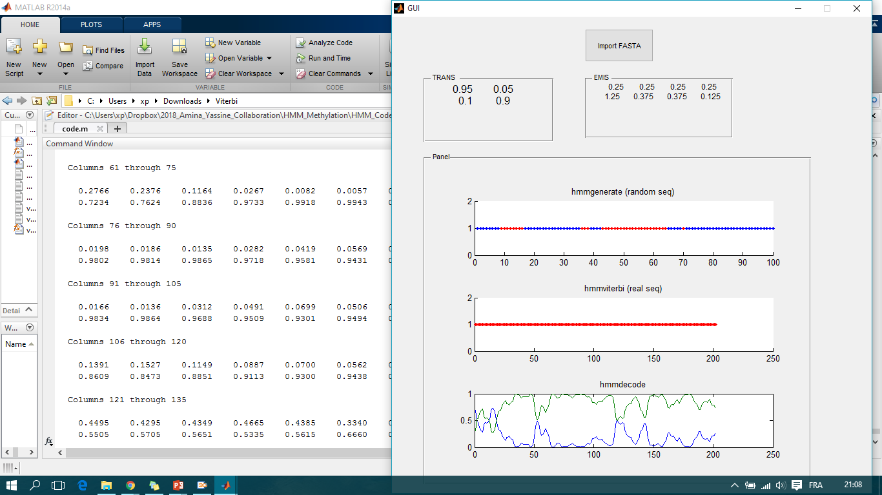
Results

Slide 9
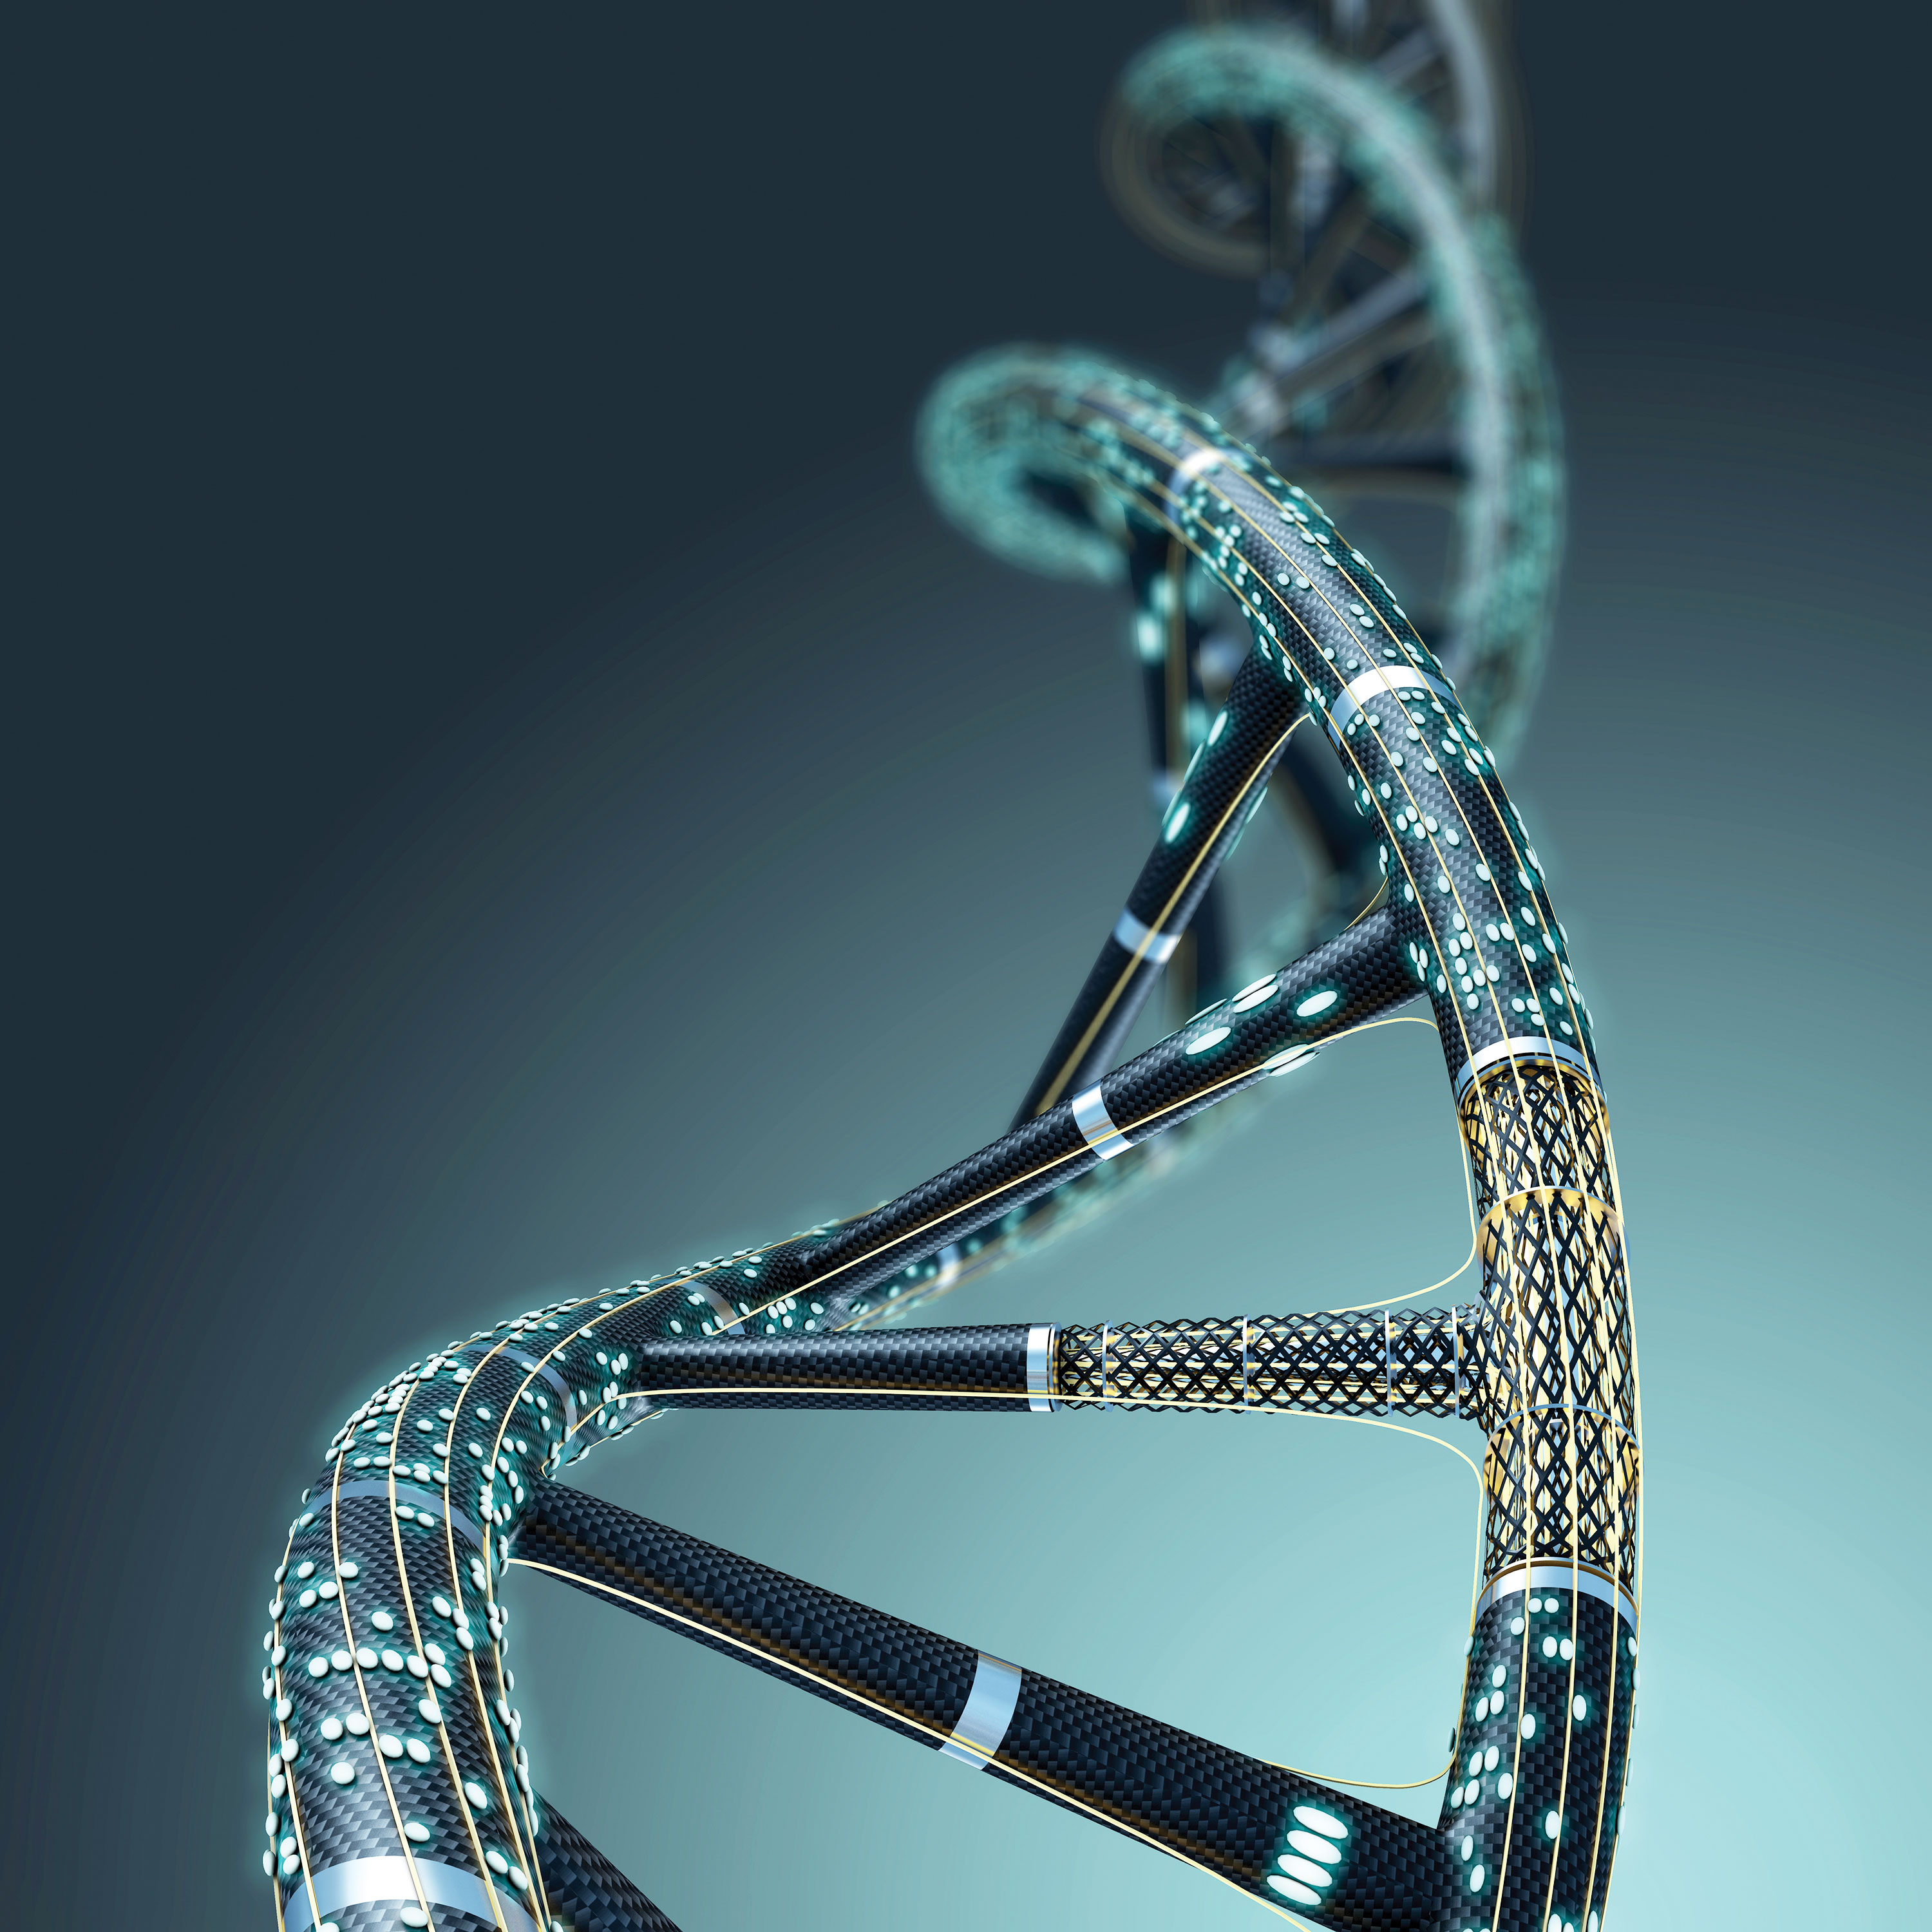
Mathematical Model for Predicting the Hypermethylations in the Tumor Suppressor Gene Promoters as a Cause of Cancer
int main()
{
// printf() displays the string inside quotation
printf("Thank you very Much!");
return 0;
}
“We are express of gene and maturation of the environment”YK
Imane Saif,
Najwa Hassou,
Yassine Kasmi,
Berjas Abumsimir,
Karam Allali,
My Mustapha Ennaji,
Hassan II University, Casablanca, Morocco

Slide 10
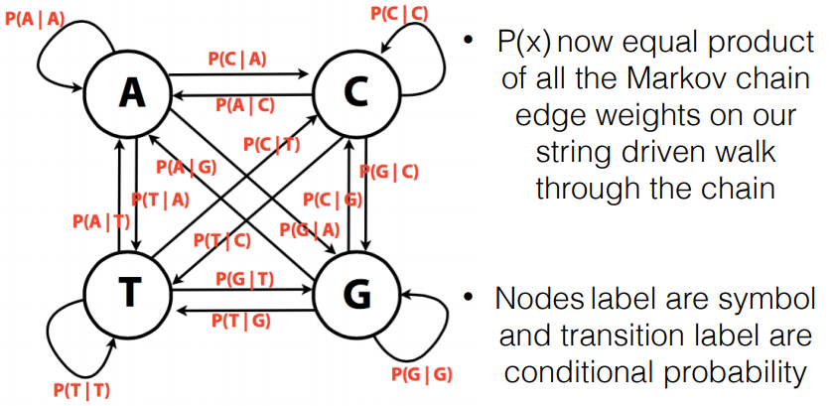
Complement

Slide 11
